Slide 1
Healthcare Fraud Detection
How insurance companies can leverage data analytics
to detect fraudulent activities
Allen Hu, Harshitha Kuriminisetty, Monica Ou,
Shaleen Swarup, Zeyu Wang

Slide 2

Health care fraud has many costs
Financial losses
The National Health Care Anti-Fraud Association (NHCAA) estimates that health care insurance fraud costs the United States roughly $68 billion annually
About 3 percent of the nation's total health care expenditures
This leads to higher premiums and out-of-pocket expenses, as well as reduced benefits and coverage
Patient harm
Subjected to unnecessary procedures
Identity theft
Notes:
Question to address: Why health care fraud is a problem-- both financially costly and has detrimental impact on patients

Slide 3

Health care fraud is a multifaceted problem
There are many different avenues for fraud to occur
Common types of healthcare fraud
Billing for services that were never performed
“Upcoding”
“Unbundling”
Submitting a claim more than once
Notes:
Question to address: why we want to focus on insurance companies

Slide 4
Why data analytics has the potential to solve the problem
Subjective nature of health care and complexity of the American health care system, health care insurance fraud has traditionally been difficult to diagnose
Fraudulent cases have certain shared identifying characteristics
We sought to create a model that would help us accurately identify fraudulent claims as well as identify patterns in these claims that would allow us to detect and prevent future fraud
Notes:
Question to address: what is the problem here, and why data analytics has the potential to address this challenge; describe the dataset

Slide 5
Description of the dataset
Beneficiary Data : Details of Customers taking Insurance with the companies
Outpatients Data: Contains data of the healthcare provider claims that are made for the customers who visited the health care center
Inpatients Data: Contains data of the healthcare provider claims of the customers who visited and got admitted in health care center
Provider Data: Containing the details of whether a provider is making fraud or non fraud claims.
Notes:
50 variables

Slide 6
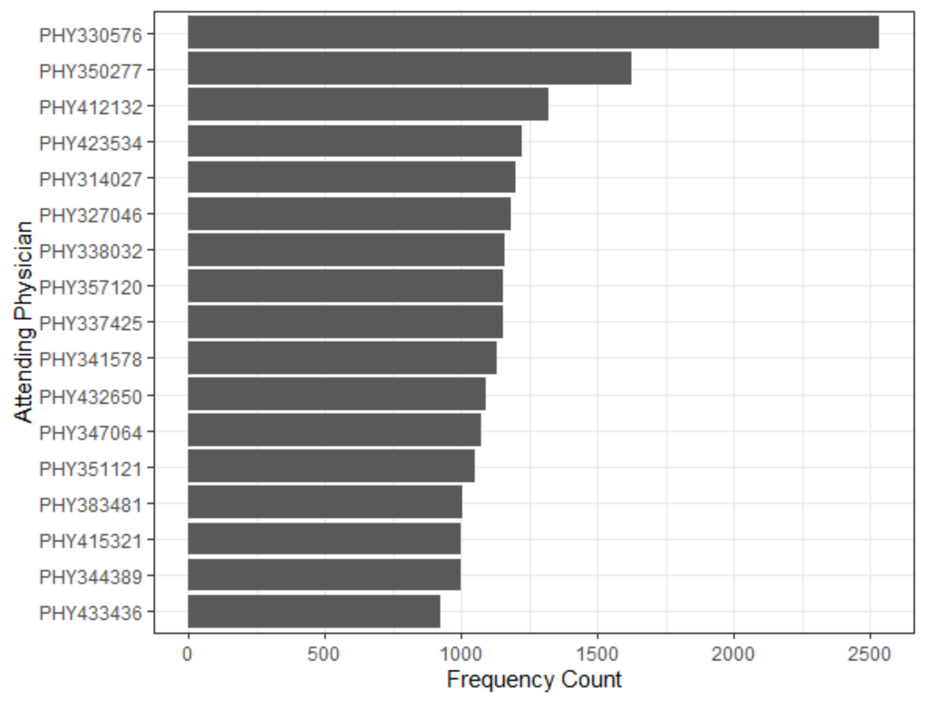
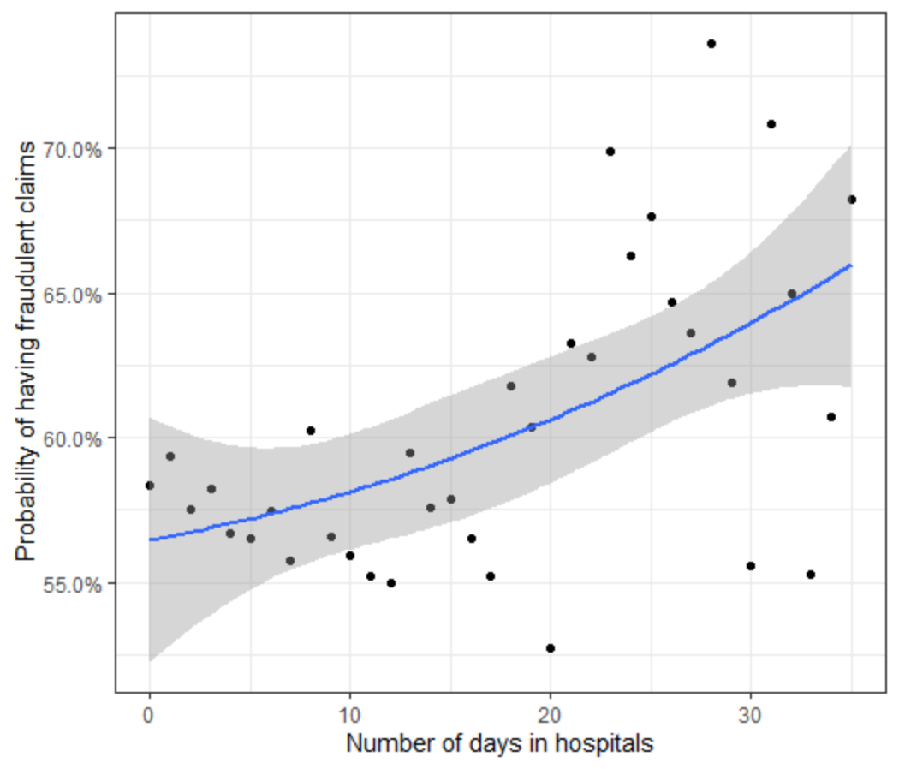
Key factors to detecting fraud
Fraudulent activities demonstrate similar patterns
Number of days in hospitals
Insurance claim amount reimbursed
Attending physicians

Slide 7
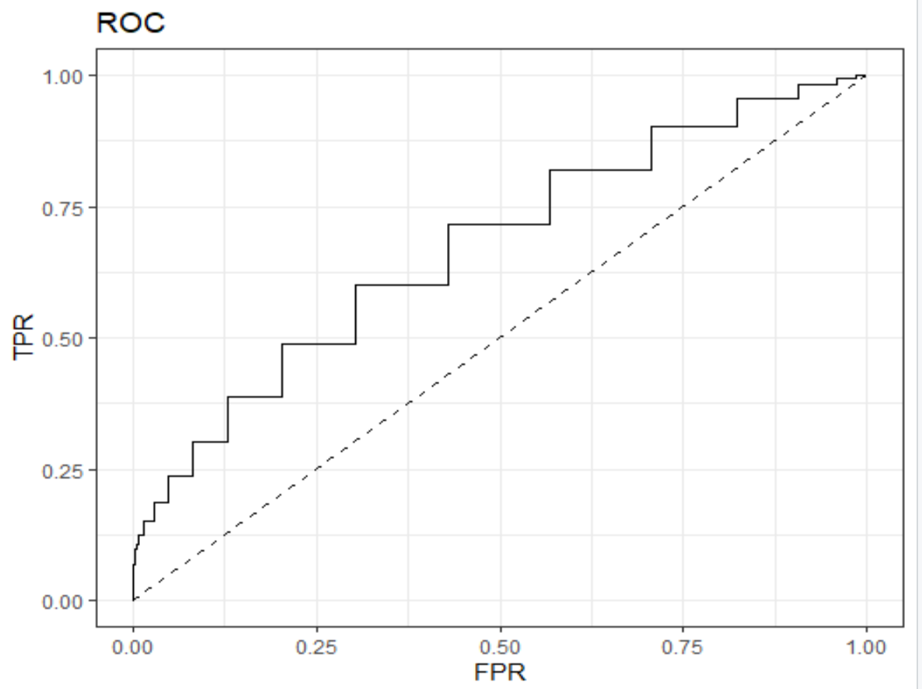
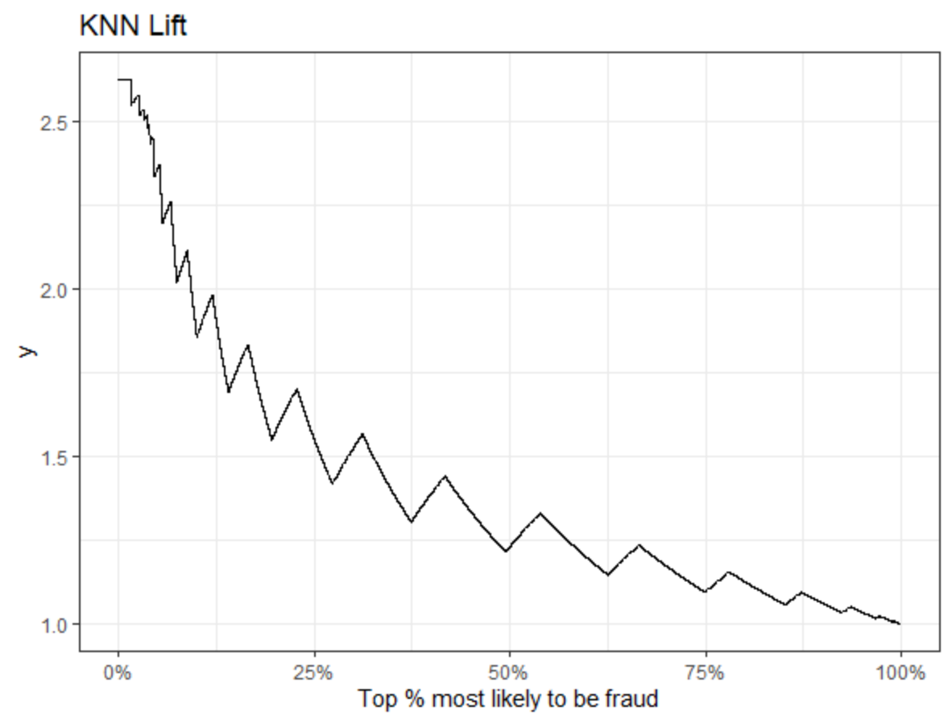
Fraud Detection Model (K-NN) Evaluation
Performance metrics: F-Score (0.4005), balance out recall and precision
By targeting the top 25% records that are most likely to be fraudulent, the model performs 1.5 times as good as random classifier
Area Under the Curve: 0.6318
Notes:
Question to address: Why we pick F-Score; what are the limitations of this model

Slide 8

Benefits to using our fraud detection model
By using this model, insurance companies will be able to:
Further scrutinize claims for fraud and potentially cut losses
With a cutoff level of 0.7, we estimate that a health insurance provider can save roughly 16% on the cases in this dataset - $14,280,910 out of $88,741,170
Lower the insurance premium and attract more customers

Slide 9
Limitations
Class Imbalance: Only a small percentage of claims are actually fraud, so the class distribution of data is highly imbalanced. This leads to decreased predictive performance in classifying the claims which are fraud.
Outpatient data is insufficient to make predictions or draw any patterns as the features which indicate fraud may not have been captured in the existing data.
The pattern of fraud can change over time. Healthcare providers can change their patterns of fraud, once they realise that the model has become proficient in detecting their fraud patterns.

Slide 10

THE END

